Slide 1
iRobo
Team : #3
Venkata Vamsi Krishna Bhuvanam, 3
Sowmya Yelmati, 32
Varun Chavakula, 4
Vikas Kondapalli, 11

Slide 2
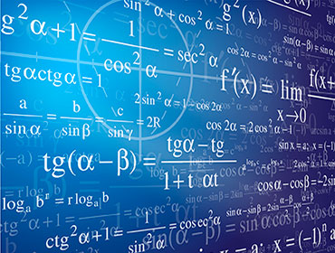
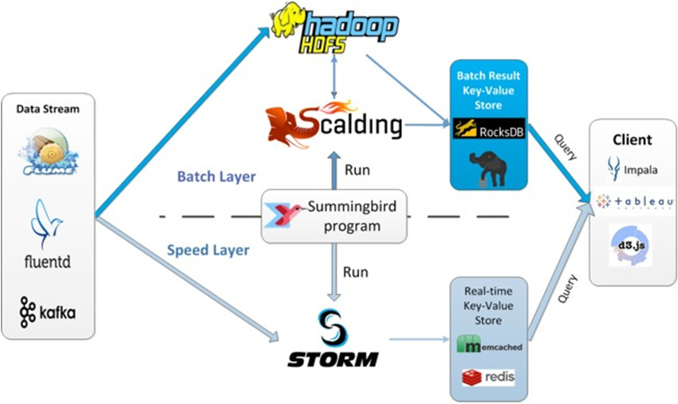
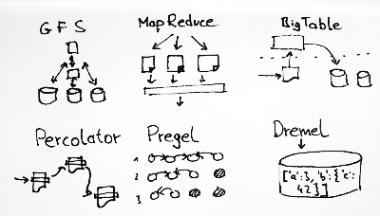
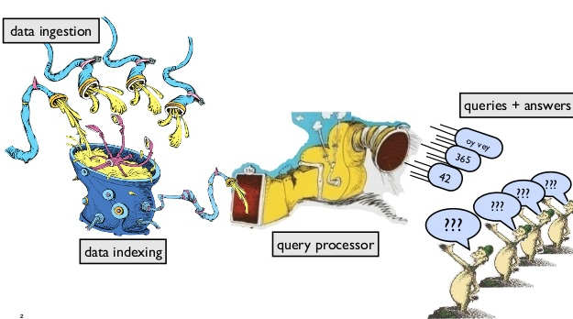
Ready for another presentation???

Slide 3
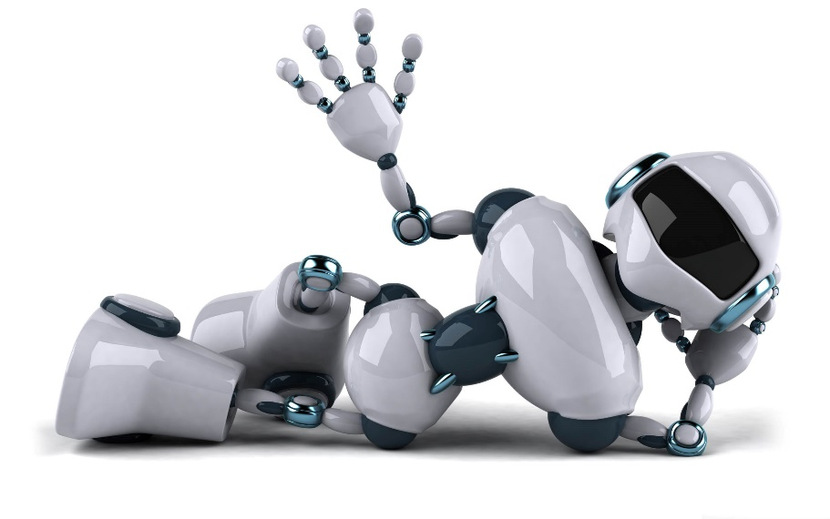
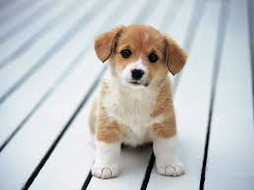
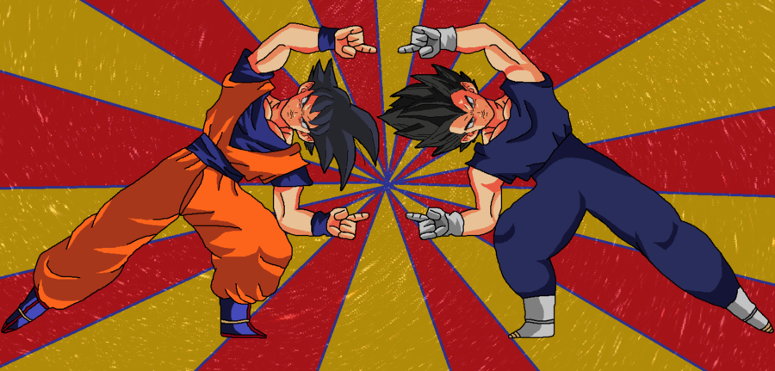
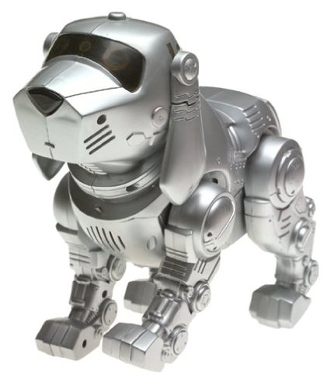
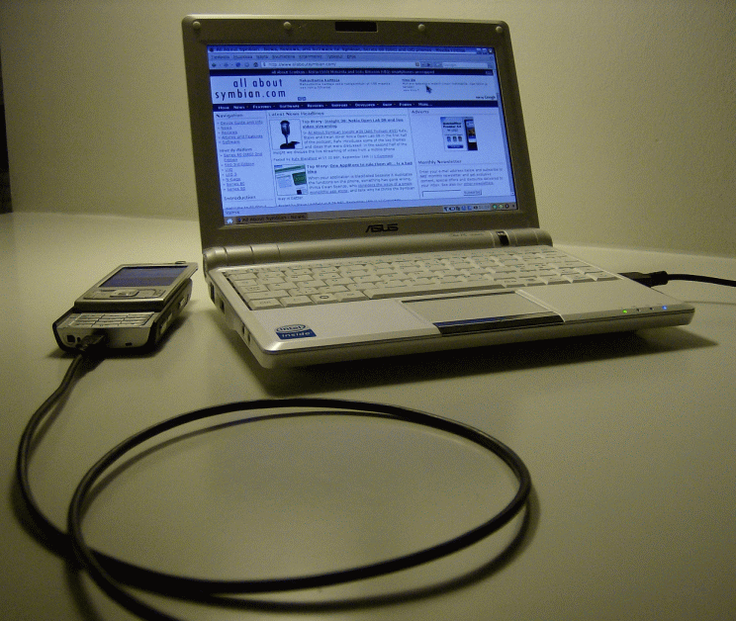
Why are we here.??
IROBO

Slide 4
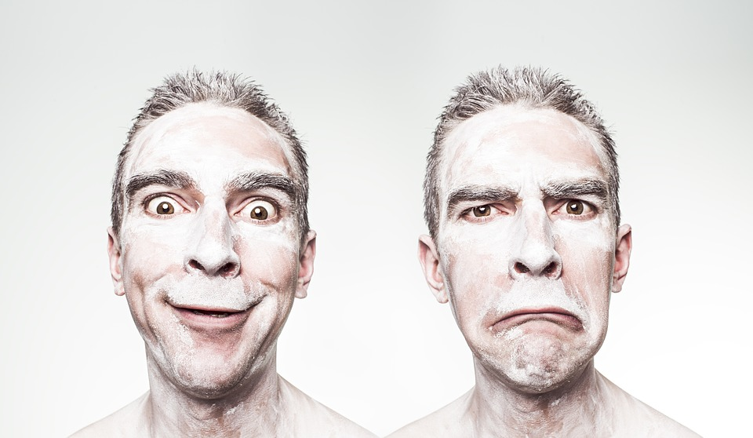

Features and training of IROBO
Google images for now.! Will be replaced by yours's later
Detect your Moods
Relax you with your favorite songs
Reach out to your friend for help.
Can be customizable to Teen Maar Beats!!!

Slide 5
Accuracy & Algorithms

Slide 6
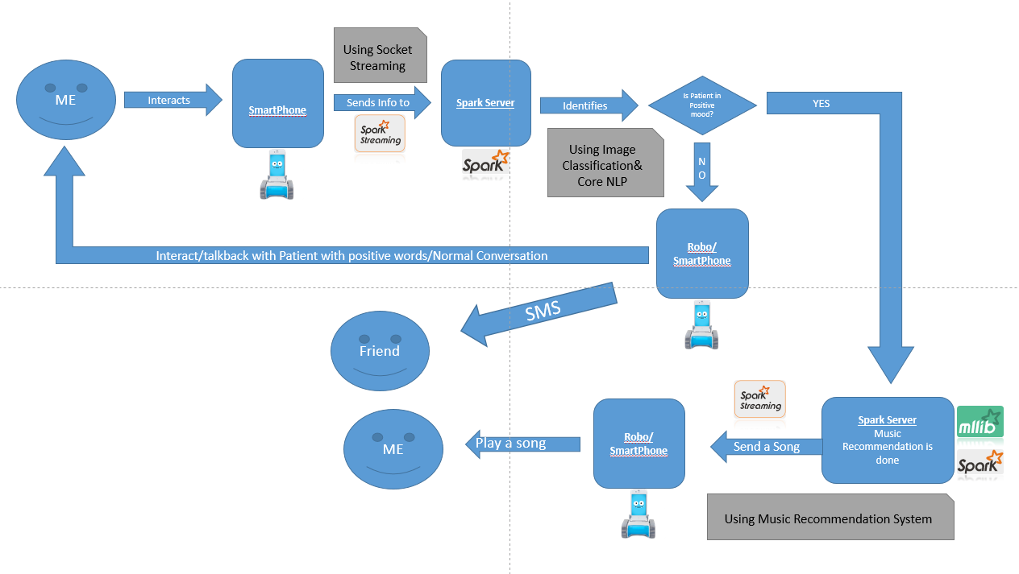
How Does it work???

Slide 7
THANK YOU
References:
https://www.google.com/search?q=google+images&source=lnms&tbm=isch&sa=X&ved=0ahUKEwjSjf-9-8PMAhVCKWMKHXr2DXIQ_AUIBygB&biw=1920&bih=979#tbm=isch&q=robot
http://www.last.fm/
http://www.dragonballz.com/
https://www.google.com/search?q=puppy&biw=1920&bih=979&source=lnms&tbm=isch&sa=X&ved=0ahUKEwilibbr-8PMAhVP4mMKHa9PDiMQ_AUIBigB
https://www.google.com/search?q=big+data+storm+architecture&biw=1920&bih=979&source=lnms&tbm=isch&sa=X&ved=0ahUKEwjuhoX--8PMAhVH1WMKHX3NDJIQ_AUIBygC

